Slide 1
Social
Buzz

Slide 2
Today's agenda
Project recap
Problem
The Analytics team
Process
Insights
Summary

Slide 3
Project Recap
Social Buzz is a fast Growing tech unicorn
needs to adapt quickly to it’s global scale.
accenture has begun a 3 month POC focusing these task:-
An audit of social buzz’s big data Practice
Recommendation for a successful IPO
Aanalysis to find Social Buzz’s top 5 popular categorie of content.

Slide 4
Problem
Over 100000 posts per day
36500000 pieces of content per year!
But how to capitalize on it when there is so much? Analysis to find Social Buzz’s top 5 most popular
categories of content.

Slide 5
Ashish Barai
Data Analyst
The Analytics team
Marcus Rompton Senior Principle
Andrew Fleming
Chief Technical Architect

Slide 6
Process
1
Data Understanding
2
Data Cleaning
3
Data Modeling
4
Data Analysis
5
Uncover Insights

Slide 7
Insights
16
Unique Categories
1897
Reaction to ‘Animal’
post
January
Month With Most Post

Slide 8
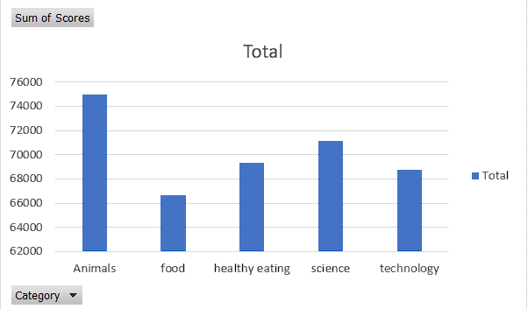
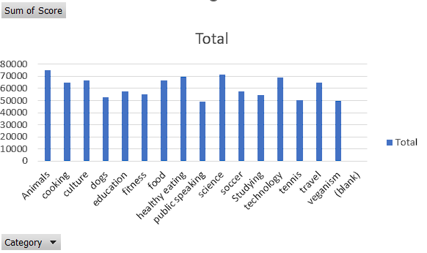

Slide 9
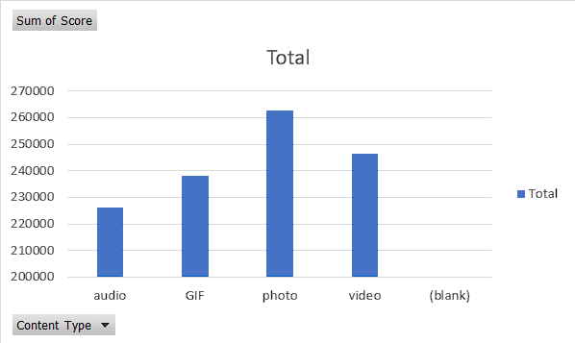

Slide 10
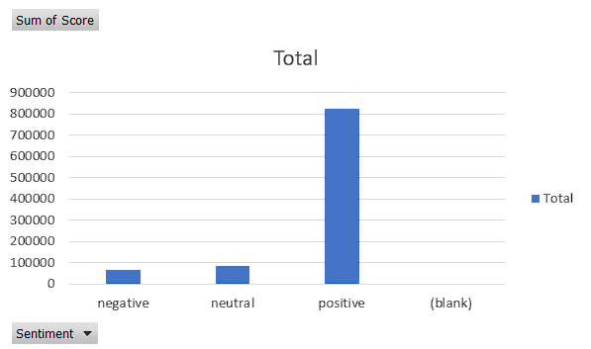

Slide 11
ANALYSIS
Animals & Science are the two most popular categories of content, showing that
People enjoy ‘real-life’ and ‘factual’ content the most.
INSIGHT
Food is a common theme with the top 5 categories with ‘Heathly-eating’ and science ranking the highest. This may give an indication to the audience within user base. Photo tops the content type And most of the people have positive sentiment. You could use this insight to create a campaign and work with healthy eating brands to boost user engagement.
NEXT STEP
This ad-hoc analysis is insightful, but its time to take this analysis into scale production for real-time understanding of your business. We can show you how to do this.
Summary

Slide 12
Thank you!
ANY QUESTIONS?

